Slide 1
Intro To Shakespeare
QVHS Drama Club 2016
Macbeth

Slide 2
Why Shakespeare?
Seriously. He’s been dead for 400 years.

Slide 3
To impede (vb.)
One fell swoop
Assassination
Knock knock! Who’s there?
Sound and Fury
The milk of human kindness
Dauntless
Be all and the end all
A sorry sight
To drug (vb.)

Slide 4
It’s still relevant
Politics
Power
Love
Envy
Greed
Friendship
Revenge
Fate
Suspicion
Guilt
Prejudice
Corruption
Grief
Sex Jokes

Slide 5
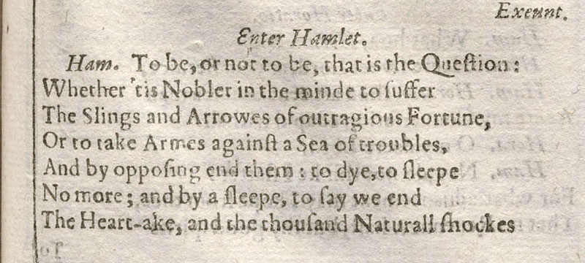
But … Shakespeare looks like this:

Slide 6
Shakespeare
$≠$
Old English

Slide 7
Old English
2. Middle English
3. Modern English
= 400 -1066
Welund him be wurman wræces cunnade,
anhydig eorl earfoþa dreag,
hæfde him to gesiþþe sorge ond longaþ,
wintercealde wræce; wean oft onfond,
= 1066 – 1400s
Hit was gret wonder that Nature Myght suffre any creature To have such sorwe, and be not ded.
= 1400s - Today
To be or not to be, that is the question.
← EARLY MODERN ENGLISH
Mr. and Mrs. Dursley, of number four, Privet Drive, were proud to say that they were perfectly normal, thank you very much.

Slide 8
Think of it like slang
1920s
1980s
1590s
The bee’s knees
It’s the berries
Speakeasy
Flapper
On the lam
Swanky
Heebie-Jeebies
Bogus
Bodacious
Radical
Gag me with a spoon
Stoked
Grody
Funky Fresh
Wherefore
Thou art
Rump-fed Ronyon
Thane
Hence
Hie thee
Twixt

Slide 9
Shakespeare Is Easy When you Have the Right Tools

Slide 10
Shakespeare Focus:
Words
What do they mean?
What is their significance?
Meter
How does the line scan?
What does this tell me?
First Folio
What can we deduce from the original spelling and punctuation?

Slide 11
Step one: Pick a Monologue

Slide 12
Is it the right Genre?
Comedy
Tragedy
History
Romances/Problem Plays

Slide 13
Is it the right Genre?
Viola (Twelfth Night)
Richard II (Richard II)
I left no ring with her: what means this lady? Fortune forbid my outside have not charm'd her! She made good view of me; indeed, so much, That sure methought her eyes had lost her tongue, For she did speak in starts distractedly. She loves me, sure; the cunning of her passion Invites me in this churlish messenger. None of my lord's ring! why, he sent her none. I am the man: if it be so, as 'tis, Poor lady, she were better love a dream.
No matter where; of comfort no man speak: Let's talk of graves, of worms, and epitaphs; Make dust our paper and with rainy eyes Write sorrow on the bosom of the earth, Let's choose executors and talk of wills: And yet not so, for what can we bequeath Save our deposed bodies to the ground? Our lands, our lives and all are Bolingbroke's, And nothing can we call our own but death And that small model of the barren earth Which serves as paste and cover to our bones.

Slide 14
Is it my type? / Does it fit the role I want?
Age
Gender
Character archetype

Slide 15
Do I connect With it?
Can I act it?
Can I make Strong Choices?
Is it “Overdone”?

Slide 16
Read the Play
CONTEXT. IT’S SERIOUSLY EVERYTHING.

Slide 17
Words
“Words, words, words”
– Hamlet, Act II, Scene 2

Slide 18
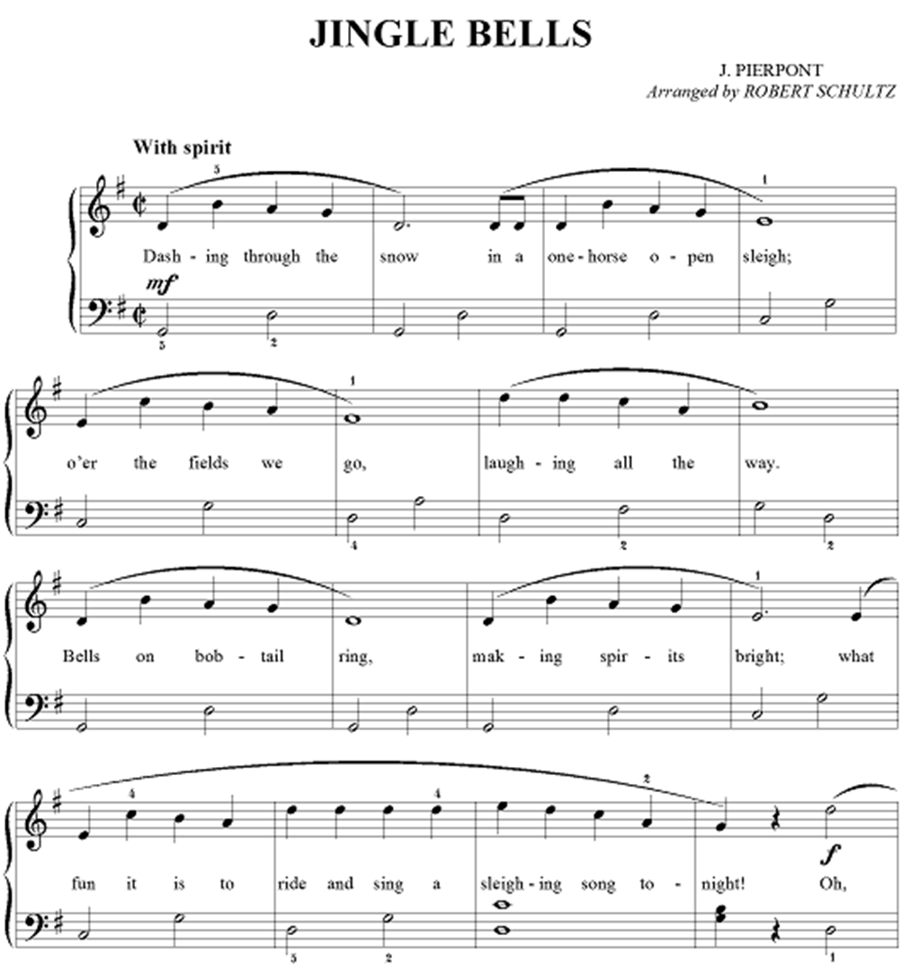

Slide 19
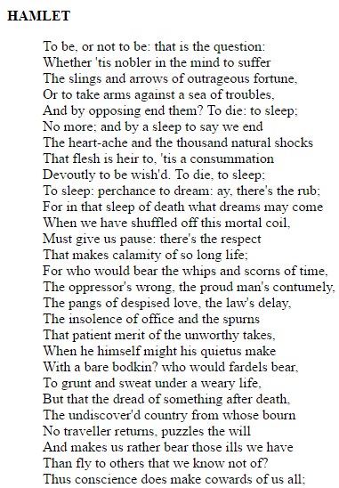
← This is kind of poetic
I think he’s talking about suicide?
Somebody hates him? And loves him? Love-hate relationship?

Slide 20
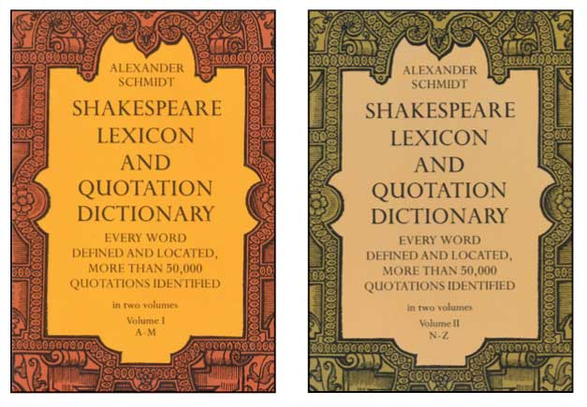
Step One: Look Up Everything
http://www.shakespeareswords.com/

Slide 21
Step One: Look up Everything Be Careful!
Julius Caesar (Act II, Scene 1)
Dictionary.com:
Portia:
Is Brutus sick? and is it physical To walk unbraced and suck up the humours Of the dank morning?
of or relating to the body as opposed to the mind.
of or relating to things perceived through the senses as opposed to the mind; tangible or concrete.

Slide 22
Step One: Look up Everything Be Careful!
Julius Caesar (Act II, Scene 1)
Portia:
Is Brutus sick? and is it physical To walk unbraced and suck up the humours Of the dank morning?

Slide 23
Step One: Look up Everything Be Careful!
Julius Caesar (Act II, Scene 1)
Lexicon:
Portia:
Is Brutus sick? and is it physical To walk unbraced and suck up the humours Of the dank morning?
medicinal, therapeutic, restorative

Slide 24
Step Two: Break Down the Thoughts
Look for:
Tone shifts
Sentence breaks (hint: One line $≠$ one thought)
New objectives
New ideas
Keyword: DYNAMIC

Slide 25
The best way to make sure you understand?

Slide 26
Paraphrase
If music be the food of love, play on; Give me excess of it, that, surfeiting, The appetite may sicken, and so die.
~ Twelfth Night (Act I, Scene 1)
If music really is the “food of love” like the poets say, then keep playing -
Play so much of it that I will get sick from it, and therefore lose my hunger for love entirely.

Slide 27
If you know 50%, the audience understands 15% If you know 95%, the Audience understands 75%

Slide 28
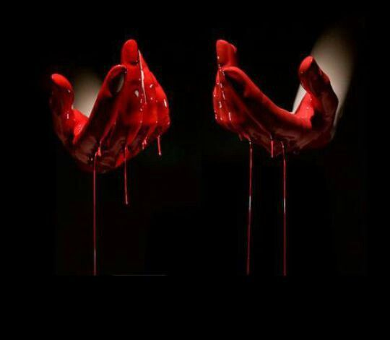
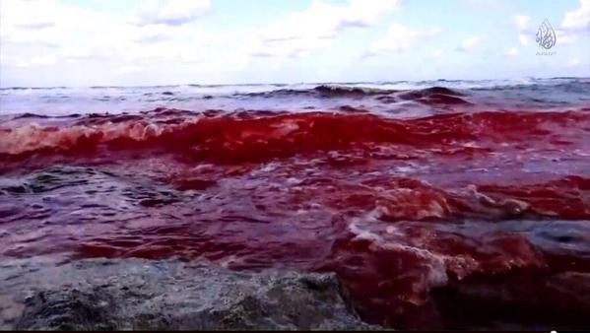
Consider Figurative Language and Imagery
Macbeth (Act II, scene 2)
Will all great Neptune’s Ocean wash this blood
Cleane from my Hand? no: this my Hand will rather
The multitudinous Seas incarnardine,
Making the Greene one Red.

Slide 29
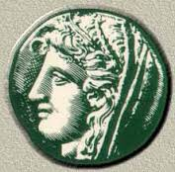
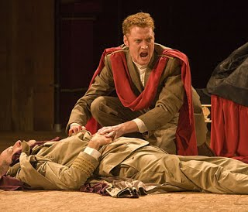
Allusions and References
Julius Caesar (Act III, scene 1)
And Caesar's spirit, ranging for revenge, With Ate by his side come hot from hell, Shall in these confines with a monarch's voice Cry 'Havoc,' and let slip the dogs of war; That this foul deed shall smell above the earth With carrion men, groaning for burial.

Slide 30
Repetition
Julius Caesar (Act III, scene 2)
Friends, Romans, Countrymen, lend me you ears;
I come to bury Caesar, not to praise him.
The evil that men do lives after them;
The good is oft interred with their bones;
So let it be with Caesar. The noble Brutus
Hath told you Caesar was ambitious:
If it were so, it was a grievous fault,
And grievously hath Caesar answer'd it.
Here, under leave of Brutus and the rest--
For Brutus is an honourable man;
So are they all, all honourable men--
Come I to speak in Caesar's funeral.
He was my friend, faithful and just to me.
But Brutus says he was ambitious;
And Brutus is an honourable man.
He hath brought many captives home to Rome
Whose ransoms did the general coffers fill:
Did this in Caesar seem ambitious?
When that the poor have cried, Caesar hath wept:
Ambition should be made of sterner stuff: Yet Brutus says he was ambitious;
And Brutus is an honourable man.
You all did see that on the Lupercal
I thrice presented him a kingly crown,
Which he did thrice refuse: was this ambition?
Yet Brutus says he was ambitious;
And, sure, he is an honourable man.
I speak not to disprove what Brutus spoke,
But here I am to speak what I do know.
You all did love him once, not without cause:
What cause withholds you then, to mourn for him?
O judgment! thou art fled to brutish beasts,
And men have lost their reason. Bear with me;
My heart is in the coffin there with Caesar,
And I must pause till it come back to me.

Slide 31
Repetition
Julius Caesar (Act III, scene 2)
Friends, Romans, Countrymen, lend me you ears;
I come to bury Caesar, not to praise him.
The evil that men do lives after them;
The good is oft interred with their bones;
So let it be with Caesar. The noble Brutus
Hath told you Caesar was ambitious:
If it were so, it was a grievous fault,
And grievously hath Caesar answer'd it.
Here, under leave of Brutus and the rest--
For Brutus is an honourable man;
So are they all, all honourable men--
Come I to speak in Caesar's funeral.
He was my friend, faithful and just to me.
But Brutus says he was ambitious;
And Brutus is an honourable man.
He hath brought many captives home to Rome
Whose ransoms did the general coffers fill:
Did this in Caesar seem ambitious?
When that the poor have cried, Caesar hath wept:
Ambition should be made of sterner stuff: Yet Brutus says he was ambitious;
And Brutus is an honourable man.
You all did see that on the Lupercal
I thrice presented him a kingly crown,
Which he did thrice refuse: was this ambition?
Yet Brutus says he was ambitious;
And, sure, he is an honourable man.
I speak not to disprove what Brutus spoke,
But here I am to speak what I do know.
You all did love him once, not without cause:
What cause withholds you then, to mourn for him?
O judgment! thou art fled to brutish beasts,
And men have lost their reason. Bear with me;
My heart is in the coffin there with Caesar,
And I must pause till it come back to me.

Slide 32
Repetition
Julius Caesar (Act III, scene 2)
Friends, Romans, Countrymen, lend me you ears;
I come to bury Caesar, not to praise him.
The evil that men do lives after them;
The good is oft interred with their bones;
So let it be with Caesar. The noble Brutus
Hath told you Caesar was ambitious:
If it were so, it was a grievous fault,
And grievously hath Caesar answer'd it.
Here, under leave of Brutus and the rest--
For Brutus is an honourable man;
So are they all, all honourable men--
Come I to speak in Caesar's funeral.
He was my friend, faithful and just to me.
But Brutus says he was ambitious;
And Brutus is an honourable man.
He hath brought many captives home to Rome
Whose ransoms did the general coffers fill:
Did this in Caesar seem ambitious?
When that the poor have cried, Caesar hath wept:
Ambition should be made of sterner stuff: Yet Brutus says he was ambitious;
And Brutus is an honourable man.
You all did see that on the Lupercal
I thrice presented him a kingly crown,
Which he did thrice refuse: was this ambition?
Yet Brutus says he was ambitious;
And, sure, he is an honourable man.
I speak not to disprove what Brutus spoke,
But here I am to speak what I do know.
You all did love him once, not without cause:
What cause withholds you then, to mourn for him?
O judgment! thou art fled to brutish beasts,
And men have lost their reason. Bear with me;
My heart is in the coffin there with Caesar,
And I must pause till it come back to me.

Slide 33
Opposites
Macbeth (Act I, Scene 3)
Macbeth
So foul and fair a day I have not seen.

Slide 34
Sound of the Language
Say that some lady, as perhaps there is, Hath for your love As you have for Olivia: you cannot love her.
~Twelfth Night (Act II, Scene 4)
as great a pang of heart

Slide 35
Sound of the Language
Say that some lady, as perhaps there is, Hath for your love as great a pang of heart As you have for Olivia: you cannot love her.
~Twelfth Night (Act II, Scene 4)

Slide 36
Let’s Review
Know what it means
Know why it’s written that way

Slide 37
Scansion
“Speak the speech, I pray you, as I pronounced it to you, trippingly on the tongue”
- Hamlet, Act III, Scene 2

Slide 38
Iambic Pentameter
But, soft! what light through yonder window breaks?
One foot

Slide 39
Iambic Pentameter
1.
2.
3.
4.
5.
But, soft! what light through yon der win dow breaks?

Slide 40
Iambic Pentameter
1.
2.
3.
4.
5.
But, soft! what light through yon der win dow breaks?

Slide 41
Iambic Pentameter
1.
2.
3.
4.
5.
But, soft! what light through yon der win dow breaks?
Iamb = Unstressed, Stressed

Slide 42
Iambic Pentameter
1.
2.
3.
4.
5.
But, soft! what light through yon der win dow breaks?
Iamb = Unstressed, Stressed

Slide 43
Iambic Pentameter
But, soft! what light through yon der win dow breaks?
Iamb = Unstressed, Stressed

Slide 44
Iambic Pentameter
Rhymed
Blank Verse
Prose

Slide 45
Rhyme
VERY high, formal speech – think of the sonnet in Romeo and Juliet
Typical of earlier plays
Rhyming couplet
Ends a scene
Makes a point
Duncan
… And with his former title greet Macbeth.
Ross
I’ll see it done.
Duncan
What he hath lost, noble Macbeth hath won.

Slide 46
Blank Verse
Good old, every day, non-rhyming iambic pentameter.
Language of noble and refined characters.

Slide 47
Prose
Paragraphs
Used by lower class and the insane.
Porter
Marry, sir, nose-painting, sleep, and urine. Lechery, sir, it provokes, and unprovokes; it provokes the desire, but it takes away the performance: therefore, much drink may be said to be an equivocator with lechery: it makes him, and it mars him; it sets him on, and it takes him off; it persuades him, and disheartens him; makes him stand to, and not stand to; in conclusion, equivocates him in a sleep, and, giving him the lie, leaves him.

Slide 48
Why Scan?
Emphasis
Rhythm
Variations

Slide 49
Why Scan?
Emphasis
Rhythm
Variations

Slide 50
Common Variations:
Trochee
Feminine ending

Slide 51
Trochee
Opposite of an iamb
Stressed, Unstressed
Banquo
Worthy Macbeth, we stay upon your leisure.

Slide 52
Feminine Ending
Extra syllables at the end of a line
Hamlet
To be or not to be that is the question.
Beginning of insanity / loss of composure.

Slide 53
How to Scan Text:
Read the line with exaggerated meter.
Tap it out if that helps.
Stop whenever you reach a point when something feels weird.

Slide 54
How to Scan Text:
Search for a “correction” for the weird meter.
Common culprits:
Change in pronunciation
Fire
Wild
Aspect

Slide 55
How to Scan Text:
Search for a “correction” for the weird meter.
Common culprits:
Cut syllables
General = Gen’ral
Heaven = Heav’n
Taken = Ta’en

Slide 56
How to Scan Text:
Search for a “correction” for the weird meter.
Common culprits:
Slurred syllables
Mercutio
Romeo
Cassius
Many a

Slide 57
How to Scan Text:
Search for a “correction” for the weird meter.
Common culprits:
Added Syllables
Ambitious
Livéd
Deservéd

Slide 58
How to Scan Text:
Search for a “correction” for the weird meter.
Common culprits:
Trochee
Look at the 1st, 3rd and 4th feet

Slide 59
How to Scan Text:
Draw conclusions.
Make choices.
Speak the speech!!

Slide 60
Now What?
Seriously, am I done?

Slide 61
Now you Know the Melody – Time to make the music

Slide 62
Make choices. Seriously. Just go for it.
Use everything you just learned as a tool to shape the performance – work with the text, not against it.
Don’t get bogged down by technicalities – act!
And most of all: HAVE FUN.

Slide 63
Review
Look up the words.
Paraphrase the verse.
Consider the language.
Do a basic scan of the text.

Slide 64
Speak the speech, I pray you, as I pronounced it to you, trippingly on the tongue: but if you mouth it, as many of your players do, I had as lief the town-crier spoke my lines.
- Hamlet, Act Iii, Scene 2

